Slide 1
Celerra System
<CelerraSystem type="system" serial="CKM00140700163" productName="VNX5200" wwCid="CKM001407001632007" version="8.1.2-51 " celerra="0">
<Query> <ClariionGeneralConfigQueryParams clariion="1"></ClariionGeneralConfigQueryParams> </Query>
Enclosure: x
<Query> <ControlStationQueryParams/> </Query> - provides IP Address for attaching EMC data to network model.
Link storage type: physical
ClariionSpQueryParams
End Points for the Celerra System
SP = Storage Processor
Disks
Utilisation
PowerSupply
<ClariionDiskQueryParams clariion="1"></ClariionDiskQueryParams>
Link storage type: logical
<Query> <ClariionRaidGroupQueryParams clariion="1" /> </Query> - provides link information, disk to LUN and also LUN Node information e.g utilisation
LUN (Pool or RAID)
Utilisation
Storage Group
Hosts
IP Address
Disks will always belong to a system – but might not participating in a LUN or RAID group.
Hence putting them lower down the hierarchy. – I wonder if these will potentially tie back into a server else where in the system.
Fs (File side) info useful – but not sure how to tie to disks/Luns at the moment
This is possibly due to a lack of information on our side – File side involves CIFs / NAS etc which aren’t configured on our system.
The same applies to the data movers which handle things like ESX host to datastore communication.
Alarms/Alerts
Event (EMC) = Alert (HG)
<Query>
<EventQueryParams start="0" verbose="true"></EventQueryParams>
</Query>

Slide 2
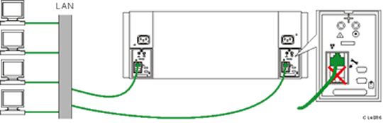
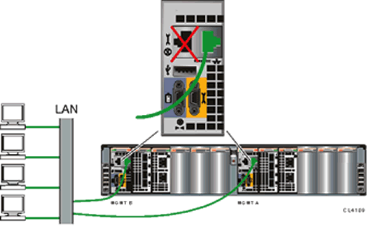
Connecting the SP A and SP B Management Ports to the Network
The following illustrations show how to properly connect the SP A and SP B management ports to the network. Make sure that you connect the Ethernet cables from the server NIC to the RJ-45 connector on the management port. There is one RJ-45 connection on each management port.
Figure 1 Magnified view of the SP management port on a CX4-120, CX4-240, and CX4-480
Figure 2 Magnified view of the SP management port on a CX4-960 (the SPE is not shown in this illustration)
http://www.emc.com/collateral/hardware/white-papers/h8217-introduction-vnx-wp.pdf

